Slide 1

TELECOM AND NETWORKS LAB

Slide 2
LAB – 1 TRANSMISSION AND ATTENUATION
GOAL : Model a transmission line using multisim and we should observe the attenuation and distortion.

Slide 3
SOFTWARE REQUIRED
NI MULTISM 14.2
OSCILLOSCOPE
LOSSY TRANSMISSION LINE
FREQUENCY GENERATOR
GROUND
COMPONENTS REQUIRED

Slide 4
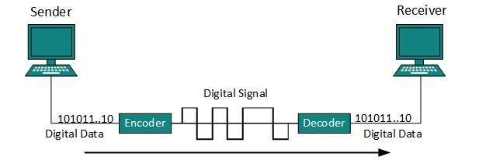
Transmission Line
Transmission line the name itself says it is a transmission medium which sends data from one point to another point.
In order to communicate with each other and for data exchange to take place , transmission of data or signal is necessary.

Slide 5
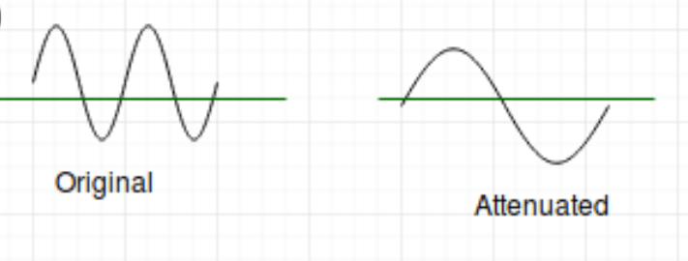
What is ATTENUATION ?
When a signal travels through the transmission medium, it experiences some resistances. The signal loses its energy to overcome it. This is known as attenuation.
It is measured in decibels(dB).

Slide 6
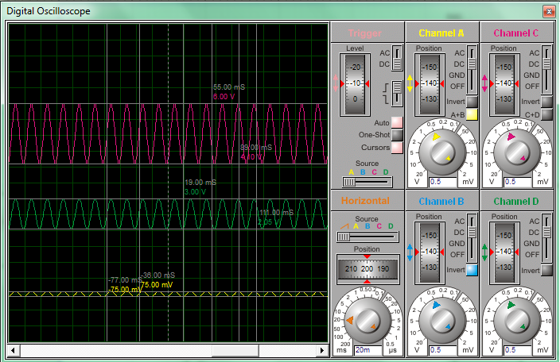

Slide 7
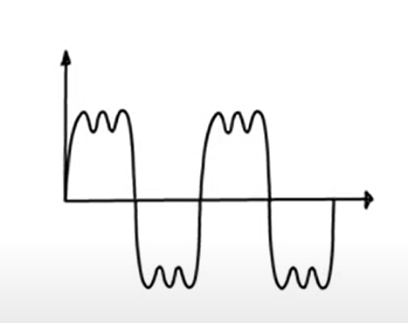
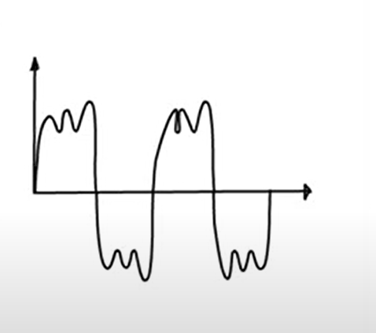
what is DISTORTION ?
Distortion can be stated as any change in a signal that alters the waveform.
Distortion, one of the reasons of transmission impairment, means a change in the shape of the received signal.

Slide 8
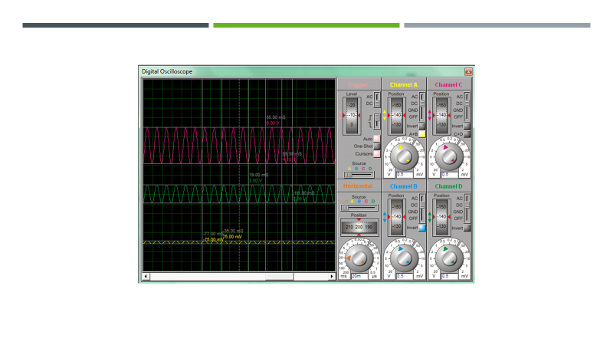
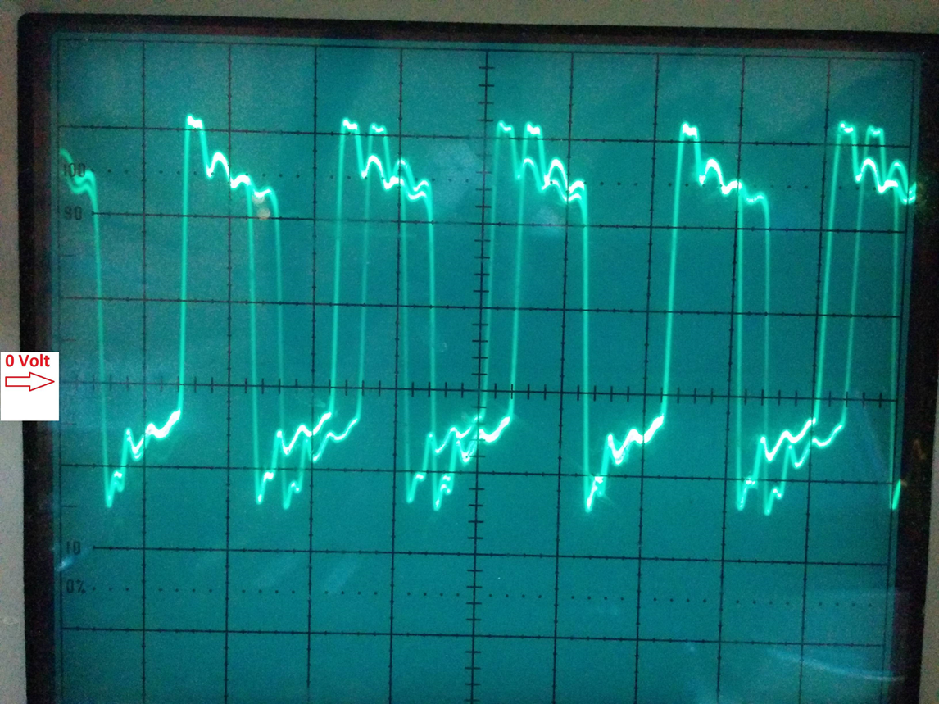

Slide 9
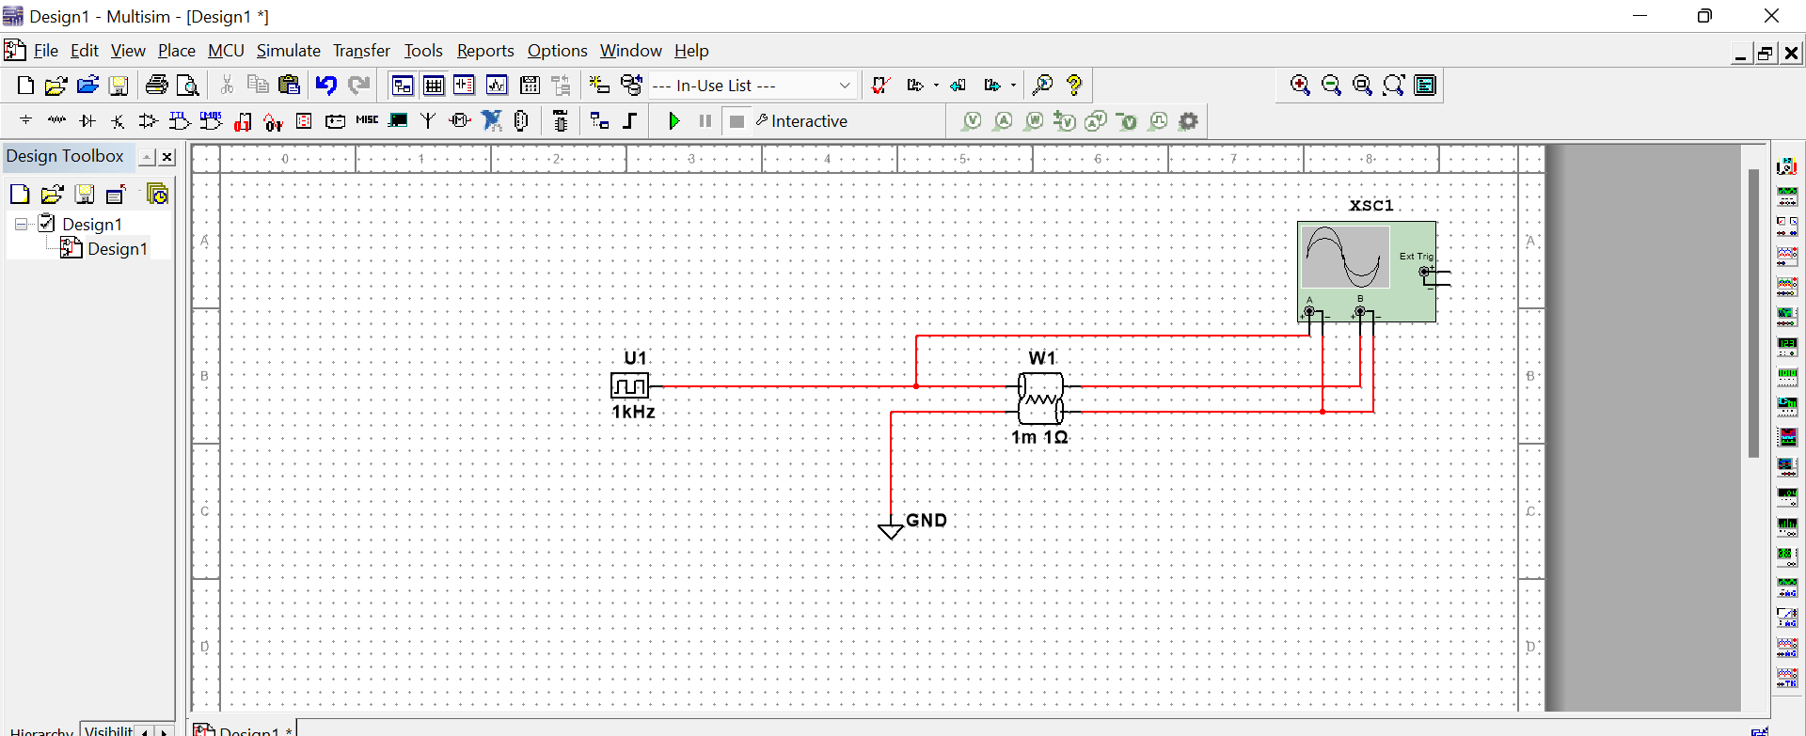
CIRCUIT DIAGRAM

Slide 10


